Slide 1
Back on Tap: A Legal Framework for Drinking Fountains in MA Schools
Cara Wilking, J.D.
Public Health Advocacy Institute
With Special Thanks for Research Assistance from Lindsey Palardy, J.D. Candidate

Slide 2
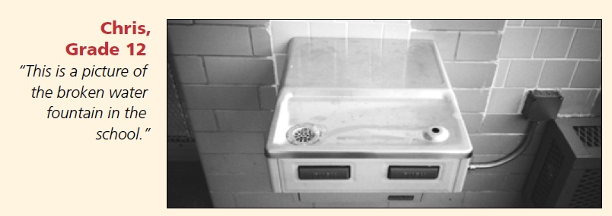
The Problem
Old School Buildings
Poor Water Quality Test Results
Negative Media Attention
Replacement of Plumbed Drinking Fountains with Bottled Water Dispensers
Lack of Funding to Renovate/Repair
Photo available at: http://archive.aft.org/pubs-reports/american_educator/issues/spring07/FacilitiesGap.pdf

Slide 3
Types of School Water
TAP
Plumbed Drinking Fountains Throughout School Building (“Bubblers”)
Tap Water Used for Food Preparation
BOTTLED
Free Bottled Water Dispensers (e.g. 5-gallon Poland Spring)
Bottled Water Sold in Vending Machines
Bottled Water Sold on the Lunch Line

Slide 4
School Drinking Water in the News
Feb 1, 2010
I-Team Discovers Unsafe Drinking Water In Schools

Slide 5
Basic Legal Framework
Access
Quality
Infrastructure
Funding

Slide 6
Access
MA Dept. of Education:
“The school shall provide a source of sanitary drinking water located in or convenient to rooms occupied by students.” 603 CMR § 18.04(3)(d) (2010).
State Plumbing Code
ONE Drinking Fountain Per 75 STUDENTS

Slide 7
Quality
MA Drinking Water Standards
Apply to public water suppliers
15 ppb of lead
1300 ppb of copper
MA Dept. of Environmental Protection
MA public water suppliers required to test two schools annually
MADEP Lead in School Drinking Water Program requested testing of all schools in 2004-2005

Slide 8
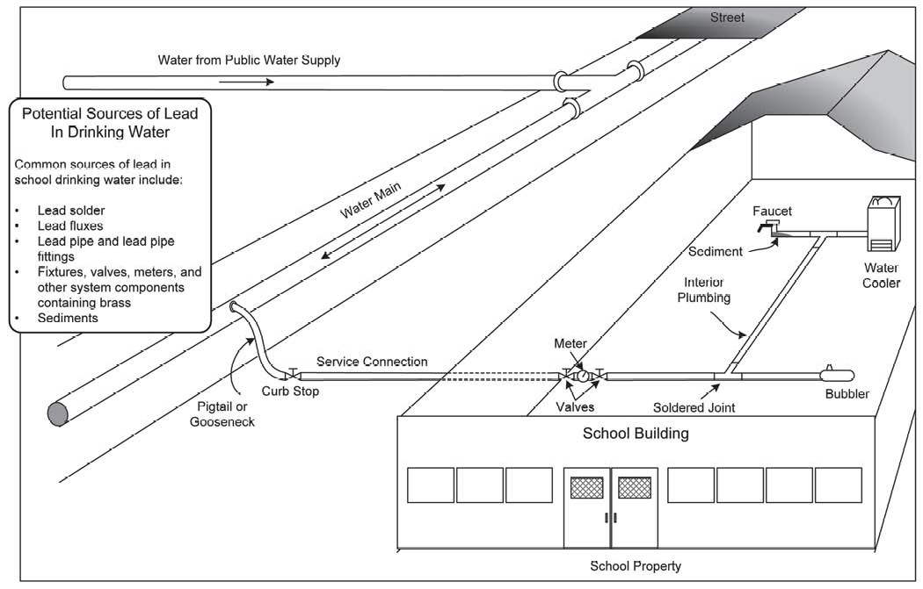
Infrastructure: School Plumbing 101
http://www.epa.gov/safewater/schools/pdfs/lead/toolkit_leadschools_guide_3ts_leadschools.pdf

Slide 9
Drinking Fountain Basics
http://www.epa.gov/safewater/schools/pdfs/lead/toolkit_leadschools_guide_3ts_leadschools.pdf

Slide 10
MA Plumbing Code Requirements
ONE BUBBLER PER 75 STUDENTS
Potable water
Nontoxic pipes (when newly installed)
Handicap accessible

Slide 11
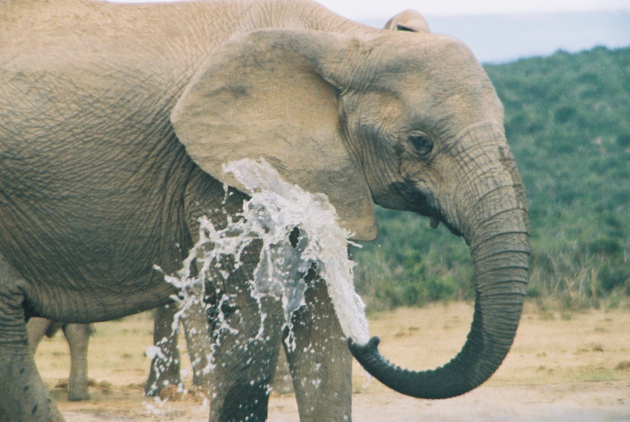
The Elephant in the Room
$
$
$

Slide 12
Funding
MA School Building Authority
Criteria for determining need:
Effect of building’s condition on educational program
School in danger of losing accreditation
Risk posed to student health and safety by structural deficiencies
Barred by statute from funding projects “necessitated, in whole or in part, by the failure…to make adequate and prudent provisions for the care and maintenance of said school.”

Slide 13
Getting Back on Tap!
Develop funding strategy
Replace pipes
Replace/add bubblers
Institute flushing regime or install automated flushing system
Filtration (least feasible option)

Slide 14
Possible Policy Changes
MA Dept. of Environmental Protection
Create enforceable requirement for routine annual school water testing and parental notification.
Create enforceable remediation requirement specifying repairs be made within a certain time period and that bottled water shall be distributed on a short term basis (no more than one school year) during renovation and repairs.
MA Dept. of Education
Make drinking fountains a requirement for school accreditation
MA School Building Authority
Include drinking fountain inventory during school rating inspections and compile information into a special report for lawmakers and agency heads.
Prioritize drinking water infrastructure upgrades in points system.
“Piggyback” pipe and fountain repair onto heating system upgrades involving plumbing.

